Slide 1


Slide 2
History
WWII had just occurred and the international community recognized the need for a statement of rights agreed upon by the international community.
Franklin and Eleanor Roosevelt were instrumental in helping to provide support for the production of such a document.

Slide 3
Where do Rights come from?
Human Right are based on values of:
Dignity
Justice
Respect
Equality
Human rights were Officially recognized as value by the world when the United Nations was set up

Slide 4
The Document
Principle drafter was John Peters Humphrey who was Canadian
Adopted in 1948
48 countries voted yes, 0 no, 8 abstentions
Preamble
30 Articles
Not recognized as law…a Declaration of Human Rights

Slide 5
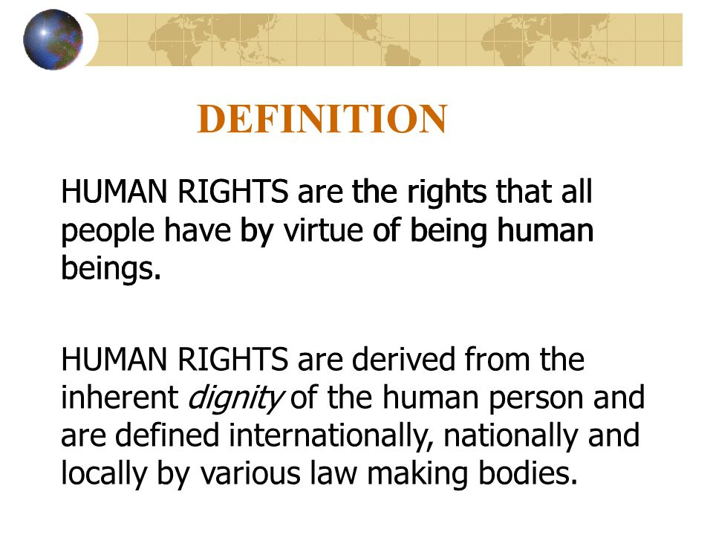

Slide 6
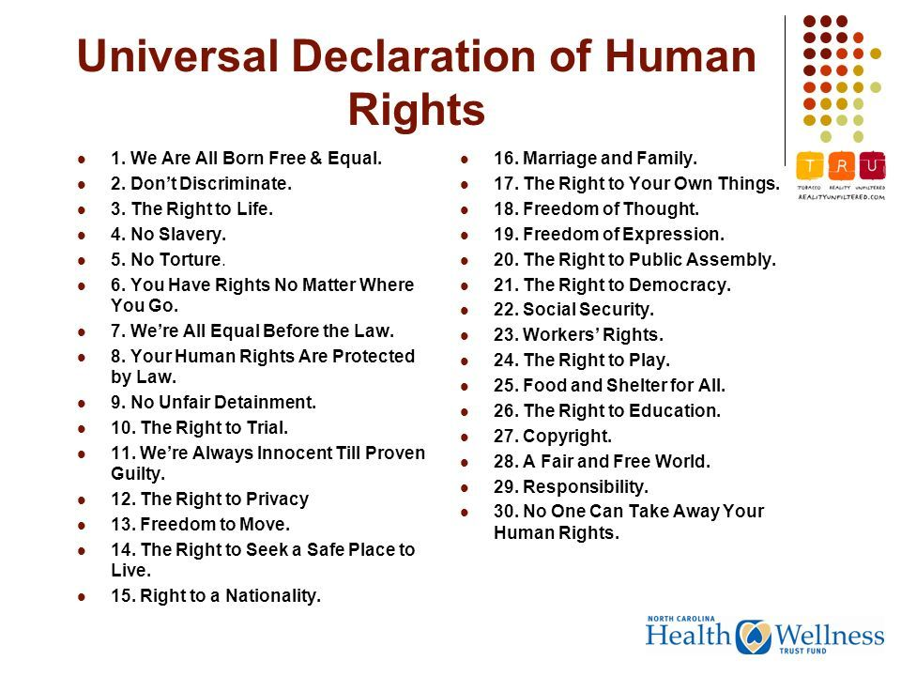

Slide 7
Cairo Declaration on Human Rights in Islam,
Aug. 5, 1990,
U.N. GAOR, World Conf. on Hum. Rts., 4th Sess., Agenda Item 5, U.N. Doc. A/CONF.157/PC/62/Add.18 (1993) [English translation].

Slide 8
Ethical Decision Making
Why Ethical Models / Theories?
No formula to solve Ethical Problems
Ethics helps us not only in distinguishing between right and wrong, but also in knowing why and on what grounds our judgment of human actions is justified
Ethical theories help:
How to decide what is right, what is wrong
To identify important principles or guidelines
You as a computer professional must consider trade-offs and make a decision!
Right, Wrong, and Okay: acts may be ethically obligatory, ethically prohibited, or ethically acceptable

